Slide 1
CSDS 451: Designing High Performant Systems for AI
Lecture 19
11/4/2025
Sanmukh Kuppannagari
sanmukh.kuppannagari@case.edu
https://sanmukh.research.st/
Case Western Reserve University

Slide 2
Outline
Accelerating Sparse Transformers – Part II

Slide 3
Announcements
WA 3 was out
Due by next Saturday

Slide 4
Next Few Classes and Deadlines
11/6 – Modeling Cluster of Accelerators
11/11 – Distributed Training Techniques
11/13 – Distributed Training Techniques (WA 3 due)
11/18 – No Class (Traveling for a conference)
11/20 – Distributed Training Techniques

Slide 5
Next Few Classes and Deadlines
11/25 – Exam
11/27 – Thanksgiving Holiday
12/2 – Guest Lecture
12/4 – Guest Lecture (WA4 due)
12/10 – NO final. Projects Due

Slide 6
Outline
Accelerating Sparse Transformers – Part II

Slide 7
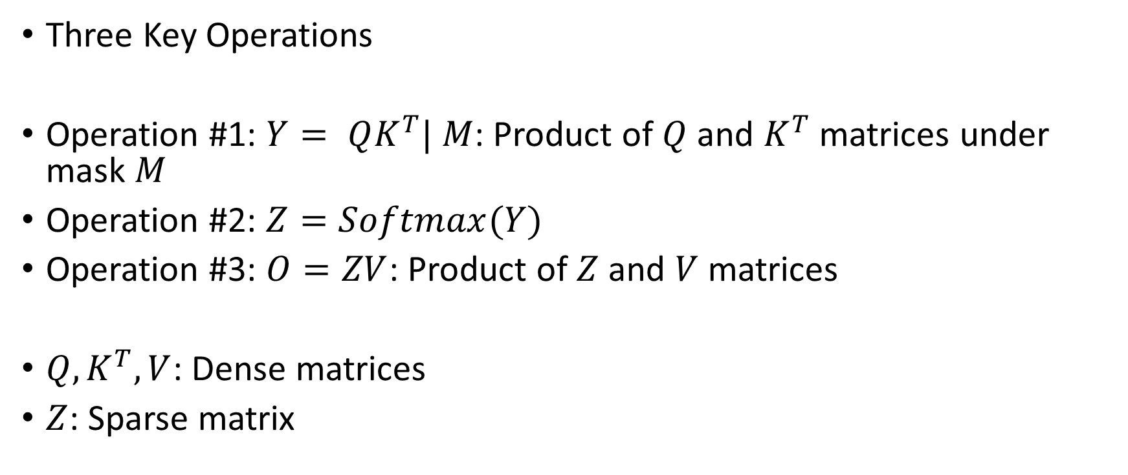
Attention with Sparse Attention Mask
Three Key Operations
Operation #1: $Y= QK^{T}| M$: Product of $Q$ and $K^{T}$ matrices under mask $M$
Operation #2: $Z=Softmax(Y)$
Operation #3: $O=ZV$: Product of $Z$ and $V$ matrices
$Q,K^{T}, V$: Dense matrices
$Z$: Sparse matrix

Slide 8


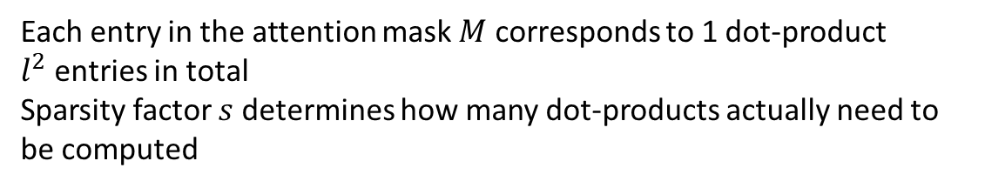

















QK Product with Attention Mask
$$x_{1}$$
$$x_{2}$$
$$x_{3}$$
$$x_{L}$$
$$Q$$
$$K$$
$$x_{1}$$
$$x_{2}$$
$$q_{1}$$
$$x_{3}$$
$$q_{2}$$
$$q_{3}$$
$$L$$
X
$$k_{1}$$
$$k_{2}$$
$$k_{3}$$
$$x_{L}$$
Each entry in the attention mask $M$ corresponds to 1 dot-product
$l^{2}$ entries in total
Sparsity factor $s$ determines how many dot-products actually need to be computed
$$l$$
$$M$$

Slide 9














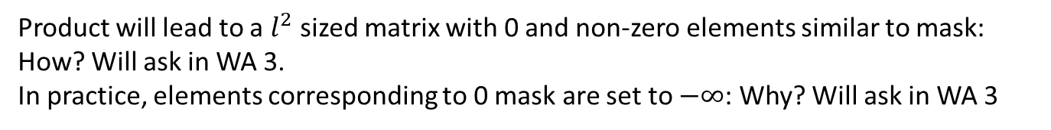



QK Product with Attention Mask
$$Y=QK^{T}$$
$$x_{1}$$
$$x_{2}$$
$$x_{3}$$
$$x_{L}$$
$$x_{1}$$
$$x_{2}$$
$$x_{3}$$
$$x_{L}$$
$$x_{1}$$
$$x_{1}$$
$$x_{2}$$
$$x_{2}$$
$$x_{3}$$
$$x_{3}$$
$$x_{L}$$
$$x_{L}$$
Product will lead to a $l^{2}$ sized matrix with 0 and non-zero elements similar to mask: How? Will ask in WA 3.
In practice, elements corresponding to 0 mask are set to $−∞$: Why? Will ask in WA 3
$$M$$

Slide 10

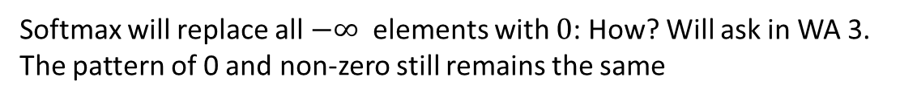
Softmax with Attention Mask
$$Z=softmax(QK^{T})$$
$$x_{1}$$
$$x_{2}$$
$$x_{3}$$
$$x_{L}$$
$$x_{1}$$
$$x_{2}$$
$$x_{3}$$
$$x_{L}$$
$$x_{1}$$
$$x_{1}$$
$$x_{2}$$
$$x_{2}$$
$$x_{3}$$
$$x_{3}$$
$$x_{L}$$
$$x_{L}$$
Softmax will replace all $−∞$ elements with $0$: How? Will ask in WA 3.
The pattern of 0 and non-zero still remains the same
$$M$$

Slide 11















Product with V Matrix
$$x_{1}$$
$$x_{2}$$
$$x_{3}$$
$$x_{L}$$
$$x_{1}$$
$$d_{v}$$
$$x_{2}$$
$$v_{1}$$
$$x_{3}$$
$$v_{2}$$
$$v_{3}$$
$$L$$
$$x_{L}$$
$$Z=softmax(QK^{T})$$
$$V$$
Product of a sparse matrix ($Z=softmax(QK^{T})$) and dense $V$ matrix

Slide 12
Attention with Sparse Attention Mask
Three Key Operations
Operation #1: $Y= QK^{T}| M$: Product of $Q$ and $K^{T}$ matrices under mask $M$
Operation #2: $Z=Softmax(Y)$
Operation #3: $O=ZV$: Product of $Z$ and $V$ matrices
$Q,K^{T}, V$: Dense matrices
$Z$: Sparse matrix

Slide 13
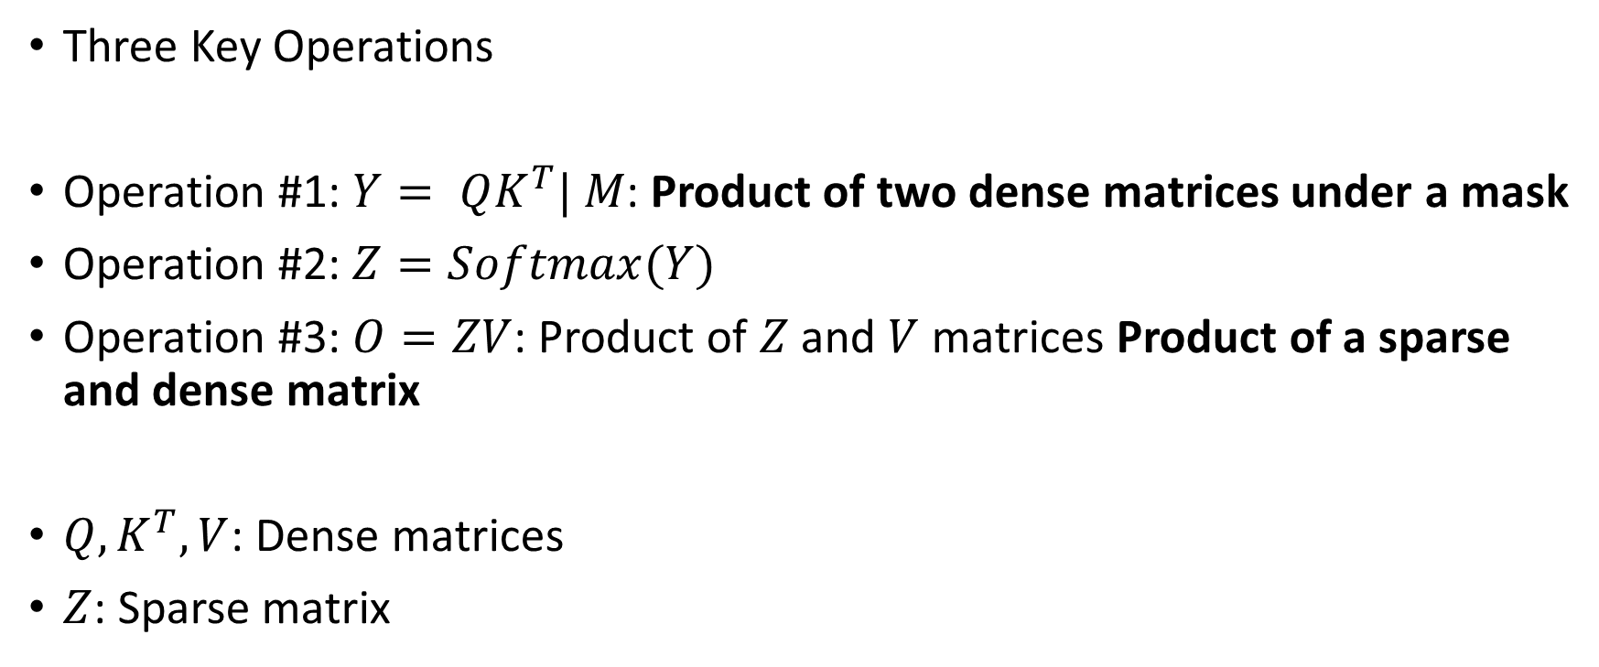
Attention with Sparse Attention Mask
Three Key Operations
Operation #1: $Y= QK^{T}| M$: Product of two dense matrices under a mask
Operation #2: $Z=Softmax(Y)$
Operation #3: $O=ZV$: Product of $Z$ and $V$ matrices Product of a sparse and dense matrix
$Q,K^{T}, V$: Dense matrices
$Z$: Sparse matrix

Slide 14
Attention with Sparse Attention Mask
Three Key Operations
Operation #1: $Y= QK^{T}| M$: Product of two dense matrices under a mask
Operation #2: $Z=Softmax(Y)$
Operation #3: $O=ZV$: Product of $Z$ and $V$ matrices Product of a sparse and dense matrix
$Q,K^{T}, V$: Dense matrices
$Z$: Sparse matrix

Slide 15
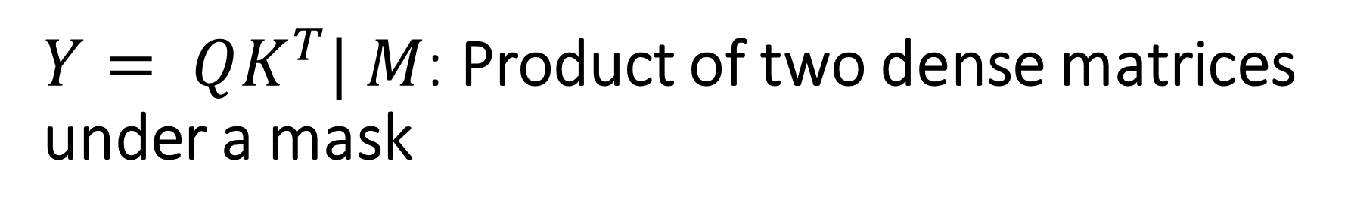
$Y= QK^{T}| M$: Product of two dense matrices under a mask
Known as Sampled Dense Dense Matrix Multiplication
Just a handful of papers on accelerating this kernel – we will discuss in next class

Slide 16
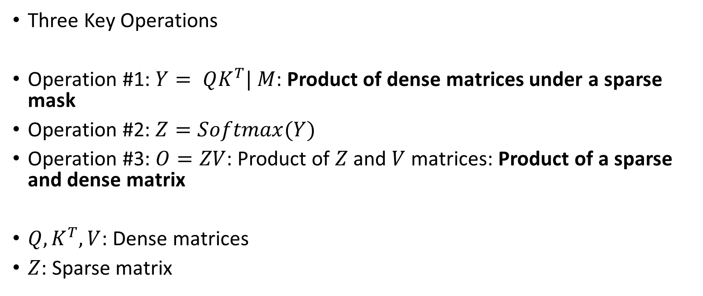
Attention with Sparse Attention Mask
Three Key Operations
Operation #1: $Y= QK^{T}| M$: Product of dense matrices under a sparse mask
Operation #2: $Z=Softmax(Y)$
Operation #3: $O=ZV$: Product of $Z$ and $V$ matrices: Product of a sparse and dense matrix
$Q,K^{T}, V$: Dense matrices
$Z$: Sparse matrix

Slide 17
Sparse-Dense Matrix Multiplication (SpMM)
An important kernel in scientific computing
In machine learning, an important kernel in Graph Neural Networks (GNNs), pruned CNNs, and Sparse Transformers
Extensive Research has been performed (and still continuing) on accelerating SpMM

Slide 18
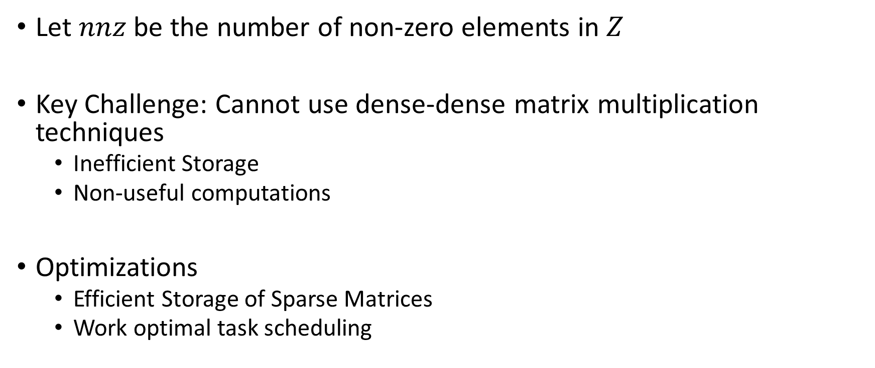
Sparse Dense Matrix Multiplication (SpMM)
Let $nnz$ be the number of non-zero elements in $Z$
Key Challenge: Cannot use dense-dense matrix multiplication techniques
Inefficient Storage
Non-useful computations
Optimizations
Efficient Storage of Sparse Matrices
Work optimal task scheduling

Slide 19





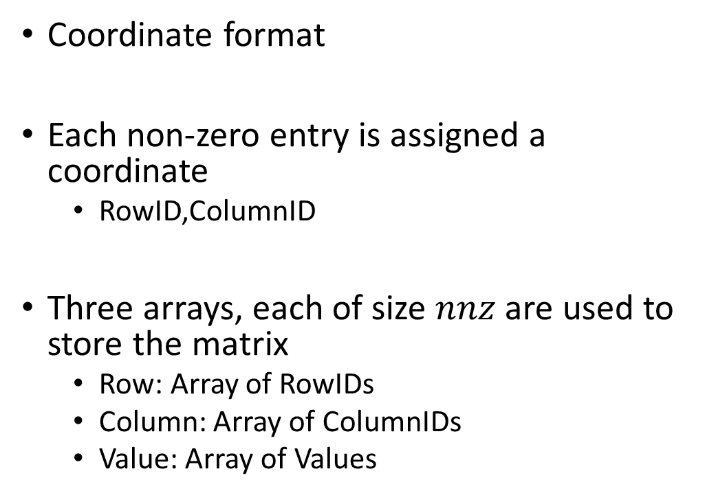






SpMM Storage Format - COO
$$L$$
Coordinate format
Each non-zero entry is assigned a coordinate
RowID,ColumnID
Three arrays, each of size $nnz$ are used to store the matrix
Row: Array of RowIDs
Column: Array of ColumnIDs
Value: Array of Values
$$x_{1}$$
$$x_{2}$$
$$x_{3}$$
$$x_{L}$$
$$x_{1}$$
$$x_{2}$$
$$x_{3}$$
$$L$$
$$x_{L}$$
$$Z$$

Slide 20
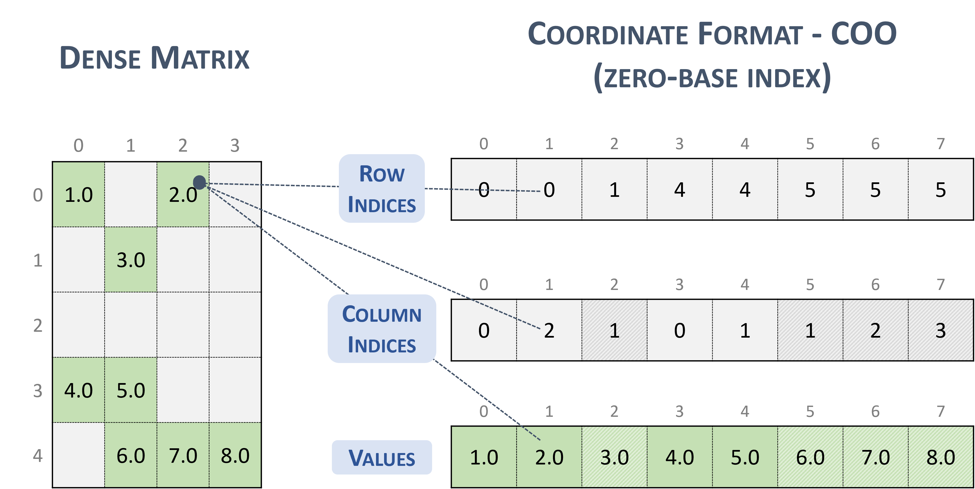
SpMM Storage Format - COO

Slide 21





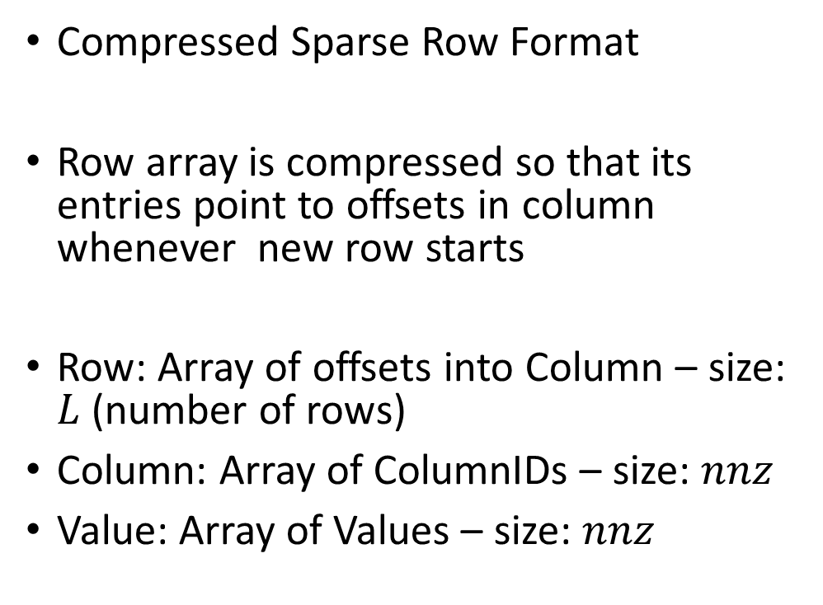






SpMM Storage Format - CSR
$$L$$
Compressed Sparse Row Format
Row array is compressed so that its entries point to offsets in column whenever new row starts
Row: Array of offsets into Column – size: $L$ (number of rows)
Column: Array of ColumnIDs – size: $nnz$
Value: Array of Values – size: $nnz$
$$x_{1}$$
$$x_{2}$$
$$x_{3}$$
$$x_{L}$$
$$x_{1}$$
$$x_{2}$$
$$x_{3}$$
$$L$$
$$x_{L}$$
$$Z$$

Slide 22
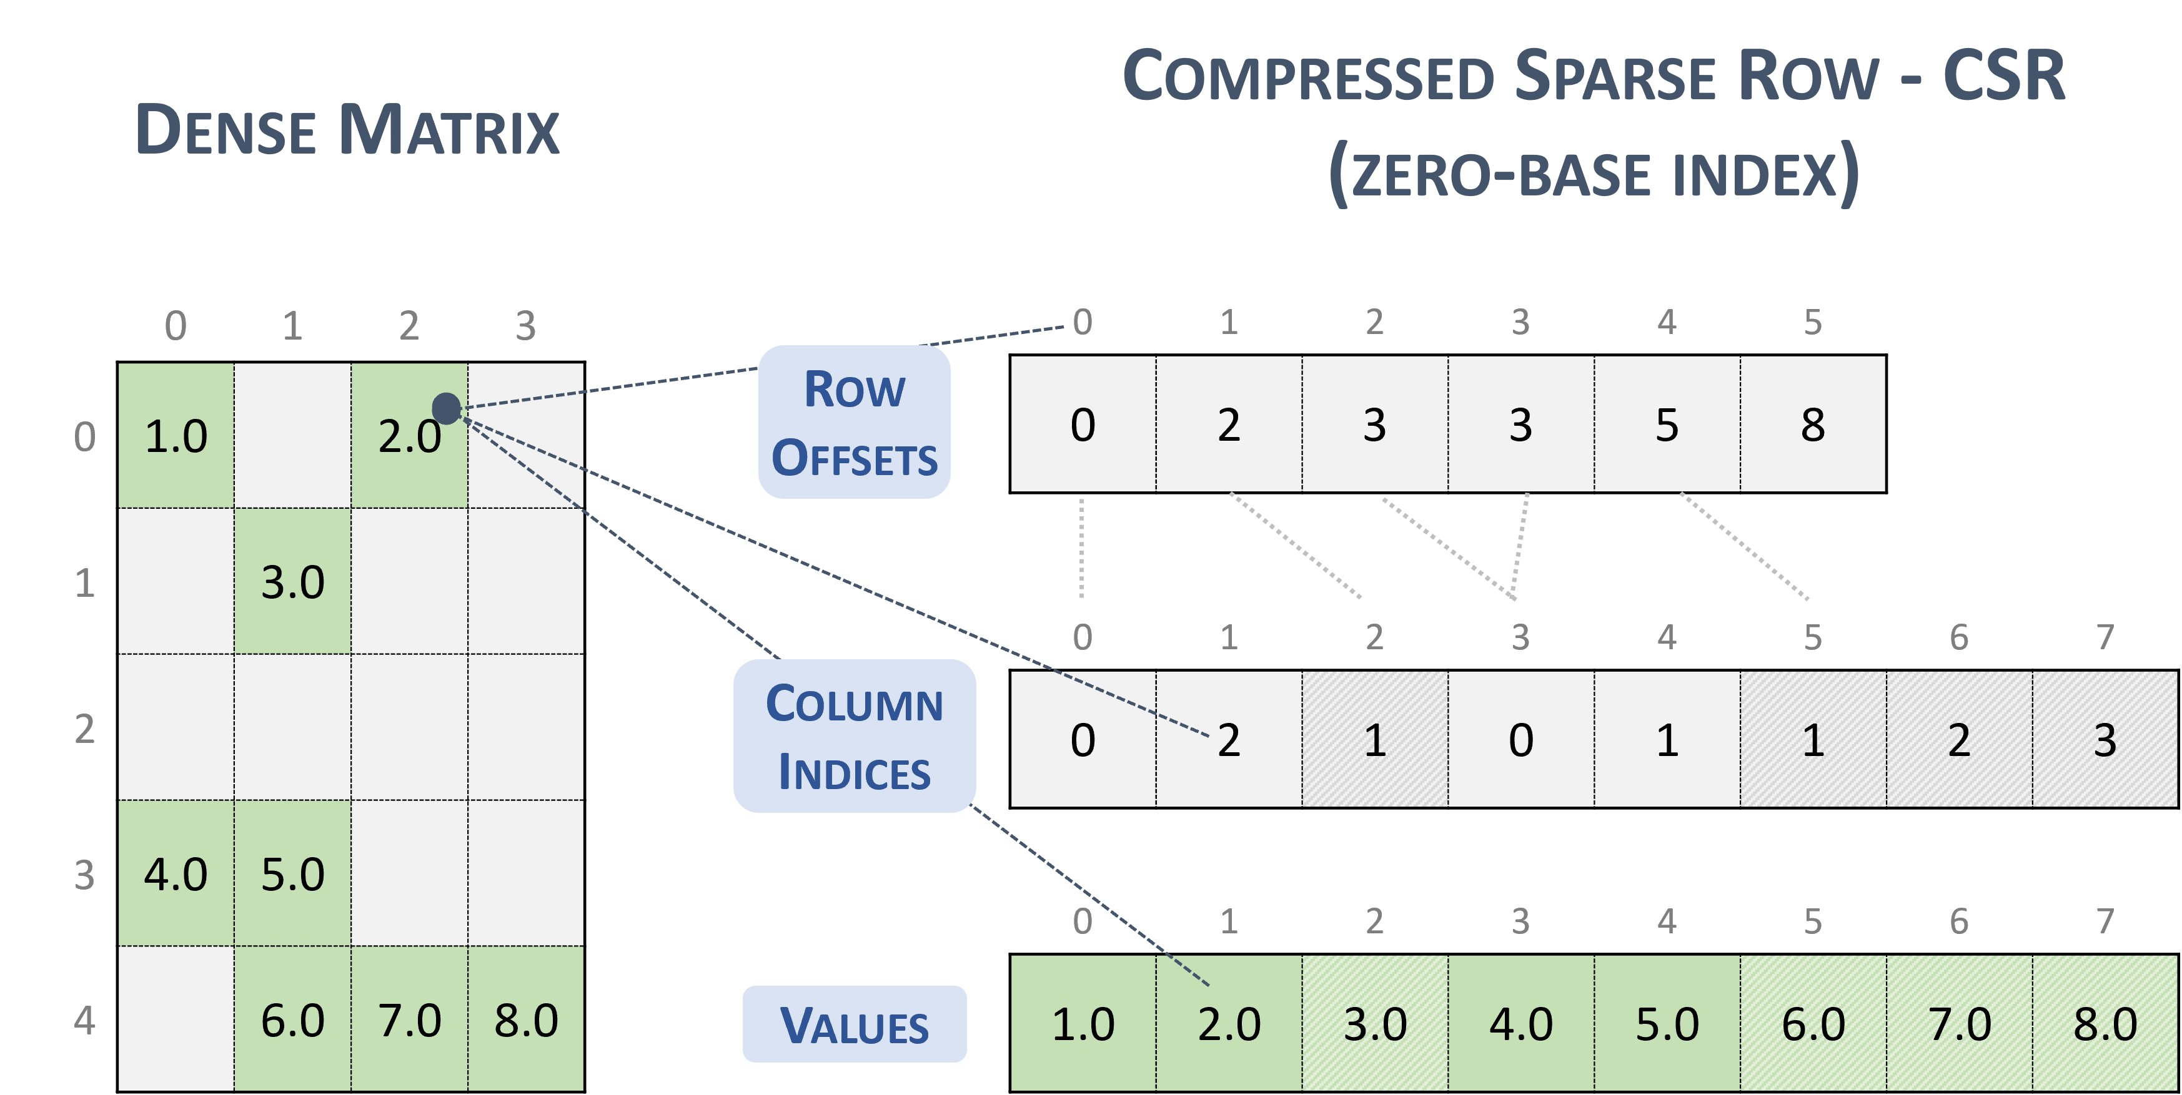
SpMM Storage Format - CSR

Slide 23
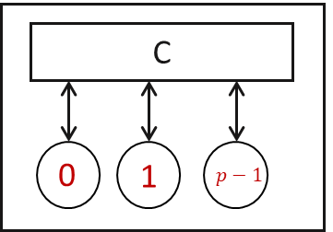
Sparse Dense Matrix Multiplication (SpMM)
Approach #1: Assign each row to a SMP

Slide 24
Sparse Dense Matrix Multiplication (SpMM)
Approach #1: Assign each row to a SMP
Processors execute the non-zero elements of the row.

Slide 25
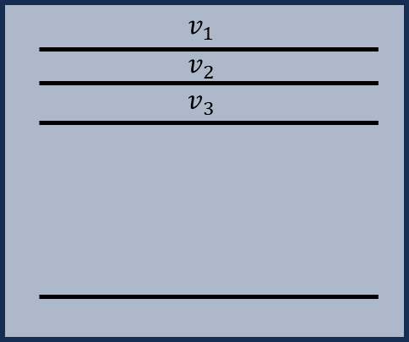
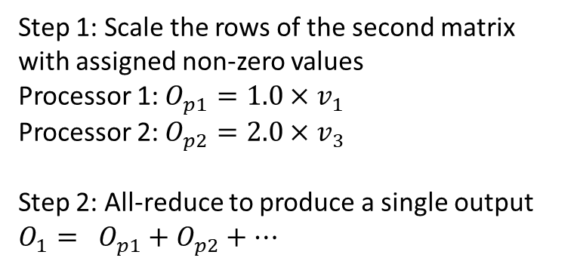
Sparse Dense Matrix Multiplication (SpMM)
Step 1: Scale the rows of the second matrix with assigned non-zero values
Processor 1: $O_{p1}=1.0×v_{1}$
Processor 2: $O_{p2}=2.0×v_{3}$
Step 2: All-reduce to produce a single output $O_{1}= O_{p1}+O_{p2}+…$
Note: Assuming processors are 1 indexed

Slide 26
Sparse Dense Matrix Multiplication (SpMM)
Question in WA 3
Given BlockID, ThreadID, can you write a GPU code for SpMM?
Divide rows evenly among the blocks of GPU
Within each block, divide column indices of rows evenly among the threads
Each thread scales rows that it owns (based on column indices) of the second matrix
Synchthreads
All-reduce of the scaled outputs to produce final output (Recall Parallel Sum? In practice, GPUs have APIs to do this)

Slide 28
Sparse Dense Matrix Multiplication (SpMM)
Approach #1: Assign each row to a SMP
Processors execute the non-zero elements of the row.
Pros: CSR format naturally leads to the assignment
Cons: Load imbalance across SMPs

Slide 29
Attention with Sparse Attention Mask
Three Key Operations
Operation #1: $Y= QK^{T}| M$: Product of dense matrices under a sparse mask
Operation #2: $Z=Softmax(Y)$
Operation #3: $O=ZV$: Product of $Z$ and $V$ matrices: Product of a sparse and dense matrix
$Q,K^{T}, V$: Dense matrices
$Z$: Sparse matrix

Slide 30
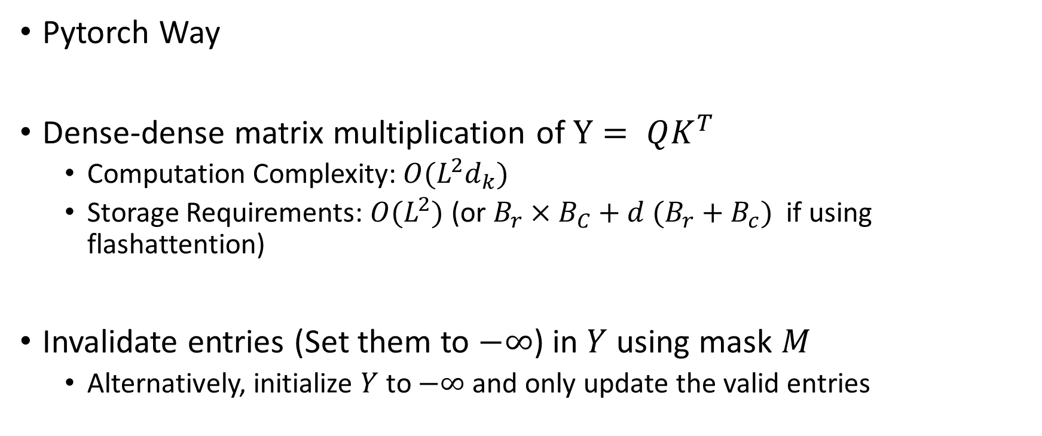
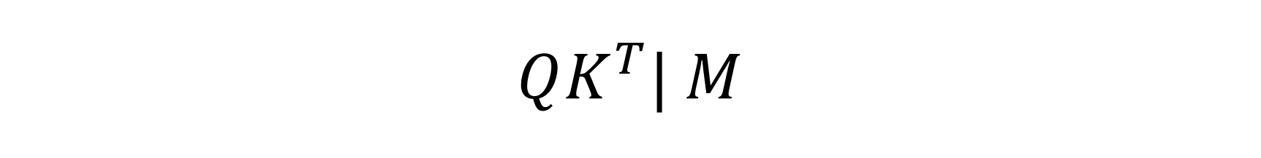
$$QK^{T}| M$$
Pytorch Way
Dense-dense matrix multiplication of $Y= QK^{T}$
Computation Complexity: $O(L^{2}d_{k})$
Storage Requirements: $O(L^{2})$ (or $B_{r}×B_{C}+d (B_{r}+B_{c})$ if using flashattention)
Invalidate entries (Set them to $−∞$) in $Y$ using mask $M$
Alternatively, initialize $Y$ to $−∞$ and only update the valid entries

Slide 31
$$QK^{T}| M$$
Can we directly use SpMM kernel?
No. But similar ideas can be utilized – Sampled Dense Dense Matrix Multiplication

Slide 32
Today’s Lecture
SDDMM Algorithm Design Idea
You will implement the algorithm in WA3
Using Flash attention on sparse masks
Block Sparsity
Algorithms to reduce the number of blocks in block sparsity

Slide 33
Today’s Lecture
SDDMM Algorithm Design Idea
You will implement the algorithm in WA3
Using Flash attention on sparse masks
Block Sparsity
Algorithms to reduce the number of blocks in block sparsity

Slide 34
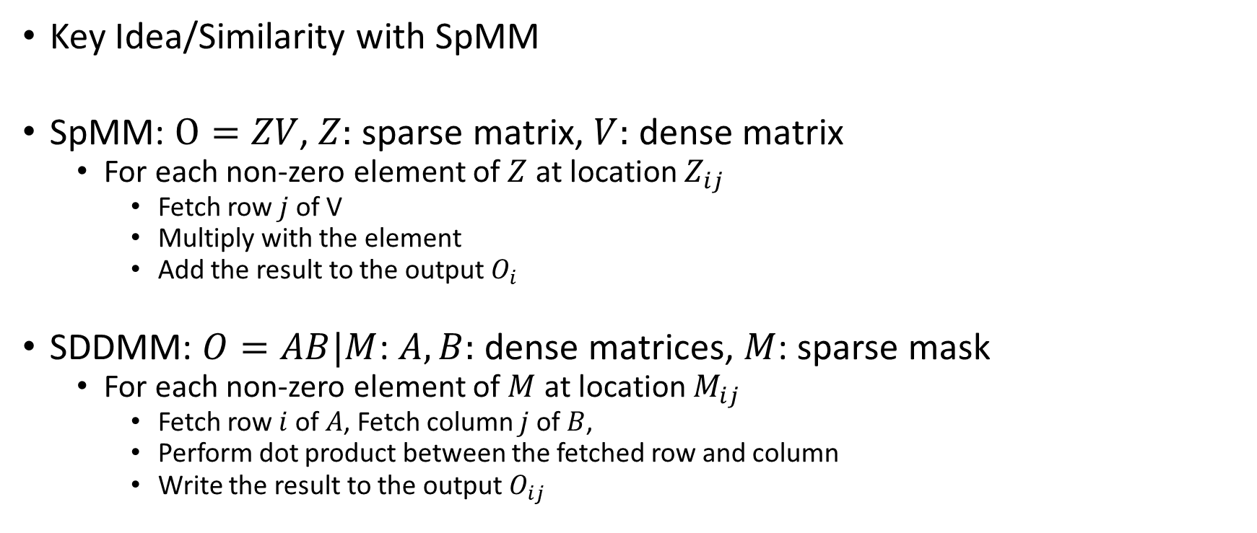
Sampled Dense Dense Matrix Multiplication (SDDMM)
Key Idea/Similarity with SpMM
SpMM: $O=ZV$, $Z:$ sparse matrix, $V:$ dense matrix
For each non-zero element of $Z$ at location $Z_{ij}$
Fetch row $j$ of V
Multiply with the element
Add the result to the output $O_{i}$
SDDMM: $O=AB|M$: $A,B:$ dense matrices, $M$: sparse mask
For each non-zero element of $M$ at location $M_{ij}$
Fetch row $i$ of $A$, Fetch column $j$ of $B$,
Perform dot product between the fetched row and column
Write the result to the output $O_{ij}$

Slide 35
Sampled Dense Dense Matrix Multiplication (SDDMM)
Key Idea/Similarity with SpMM
For each non-zero, instead of a vector scaling operation
You perform a dot product
WA3, second part of Q5
I will make that extra credits. (so 10 points extra credits)
Will not ask in exam
(This lecture is already getting too big :’-) )

Slide 36
Today’s Lecture
SDDMM Algorithm Design Idea
You will implement the algorithm in WA3
Using Flash attention on sparse masks
Block Sparsity
Algorithms to reduce the number of blocks in block sparsity

Slide 37




































Recall: Flashattention
$${w_{11}v}_{1}+w_{12}v_{2}+ …+w_{1L}v_{L}$$
$${w_{21}v}_{1}+w_{22}v_{2}+ …+w_{2L}v_{L}$$
$$B_{r}$$
$${w_{31}v}_{1}+w_{32}v_{2}+ …+w_{3L}v_{L}$$
$$k_{1}$$
$$k_{2}$$
$$k_{3}$$
$$k_{L}$$
$$L$$
$${w_{L1}v}_{1}+w_{L2}v_{2}+ …+w_{LL}v_{L}$$
$$B_{c}$$
=
$$d_{v}$$
$$q_{1}$$
$$w_{11}$$
$$w_{12}$$
$$w_{13}$$
…
$$w_{1L}$$
$$v_{1}$$
$$q_{2}$$
$$B_{r}$$
$$v_{2}$$
$$B_{c}$$
$$w_{21}$$
…
$$w_{2L}$$
$$v_{3}$$
$$w_{22}$$
$$w_{23}$$
$$L$$
X
$$q_{L}$$
…
$$w_{LL}$$
$$v_{L}$$
$$w_{L1}$$
$$w_{L2}$$
$$w_{L3}$$
$$L$$
$$d_{v}$$

Slide 38
With Mask (so crowded)
$${w_{11}v}_{1}+w_{12}v_{2}+ …+w_{1L}v_{L}$$
$${w_{21}v}_{1}+w_{22}v_{2}+ …+w_{2L}v_{L}$$
$$B_{r}$$
$${w_{31}v}_{1}+w_{32}v_{2}+ …+w_{3L}v_{L}$$
$$k_{1}$$
$$k_{2}$$
$$k_{3}$$
$$k_{L}$$
$$L$$
$${w_{L1}v}_{1}+w_{L2}v_{2}+ …+w_{LL}v_{L}$$
$$B_{c}$$
=
$$d_{v}$$
$$q_{1}$$
$$w_{11}$$
$$w_{12}$$
$$w_{13}$$
…
$$w_{1L}$$
$$v_{1}$$
$$q_{2}$$
$$B_{r}$$
$$v_{2}$$
$$B_{c}$$
$$w_{21}$$
…
$$w_{2L}$$
$$v_{3}$$
$$w_{22}$$
$$w_{23}$$
$$L$$
X
$$q_{L}$$
…
$$w_{LL}$$
$$v_{L}$$
$$w_{L1}$$
$$w_{L2}$$
$$w_{L3}$$
$$L$$
$$d_{v}$$

Slide 39





Flash Attention on Attention Mask
$$B_{c}$$
$$M$$
$$QK^{T}/Y$$
$$B_{r}$$
$$B_{c}=B_{r}=2$$

Slide 40
Flash Attention on Attention Mask
$$M$$
$$QK^{T}/Y$$
$$B_{c}=B_{r}=2$$

Slide 41
Flash Attention on Attention Mask
$$M$$
$$QK^{T}/Y$$
$$B_{c}=B_{r}=2$$

Slide 42
Flash Attention on Attention Mask
$$M$$
$$QK^{T}/Y$$
$$B_{c}=B_{r}=2$$

Slide 43
Flash Attention on Sparse Attention Mask
Pretty much the same thing happens
If a block has at least one non-zero element, Flashattention ignores the mask and computes the entire block

Slide 44

Flash Attention on Attention Mask
$$M$$
$$QK^{T}$$
$$B_{c}=B_{r}=2$$
Flashattention will ignore the mask
Notice how all the elements are getting calculated

Slide 45
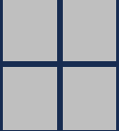
Flash Attention on Attention Mask
$$M$$
$$QK^{T}$$
$$B_{c}=B_{r}=2$$
Flashattention will ignore the mask
Notice how all the elements are getting calculated

Slide 46
Flash Attention on Attention Mask
$$M$$
$$QK^{T}$$
$$B_{c}=B_{r}=2$$
Flashattention will ignore the mask
Notice how all the elements are getting calculated

Slide 47
Flash Attention on Attention Mask
$$M$$
$$QK^{T}$$
$$B_{c}=B_{r}=2$$
Flashattention will ignore the mask
Notice how all the elements are getting calculated
If a block is fully empty, Flashattention will ignore it

Slide 48
Flash Attention on Attention Mask
$$M$$
$$QK^{T}$$
$$B_{c}=B_{r}=2$$
Flashattention will ignore the mask
Notice how all the elements are getting calculated

Slide 49
Flash Attention on Attention Mask
$$M$$
$$QK^{T}$$
$$B_{c}=B_{r}=2$$
Flashattention will ignore the mask
Notice how all the elements are getting calculated

Slide 50
Flash Attention on Attention Mask
Total Memory Needed?

Slide 51

Flash Attention on Attention Mask
Total Memory Needed? Still $O(M)$, cache size
Total Computations?

Slide 52
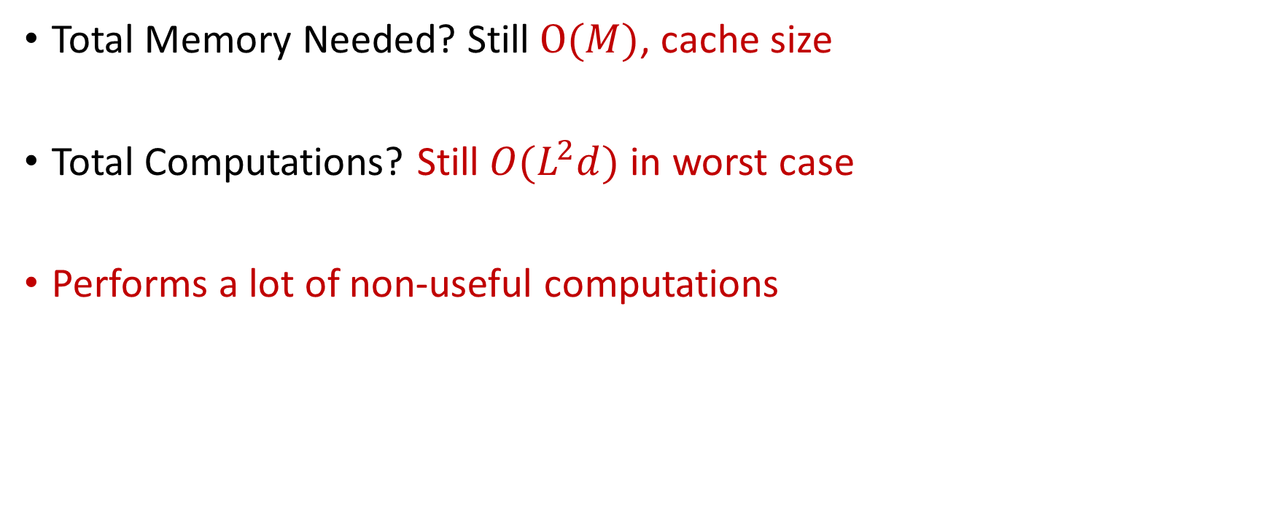
Flash Attention on Attention Mask
Total Memory Needed? Still $O(M)$, cache size
Total Computations? Still $O(L^{2}d)$ in worst case
Performs a lot of non-useful computations

Slide 53
How to Improve Performance?
???

Slide 54
How to Improve Performance?
Idea #1: Design masks that have block like structure
Non-zeros are packed together to get dense blocks on which Flashattention performs the computations
Idea #2: Reorder the attention mask to achieve better block like structure

Slide 55
Today’s Lecture
SDDMM Algorithm Design Idea
You will implement the algorithm in WA3
Using Flash attention on sparse masks
Block Sparsity
Algorithms to reduce the number of blocks in block sparsity

Slide 56
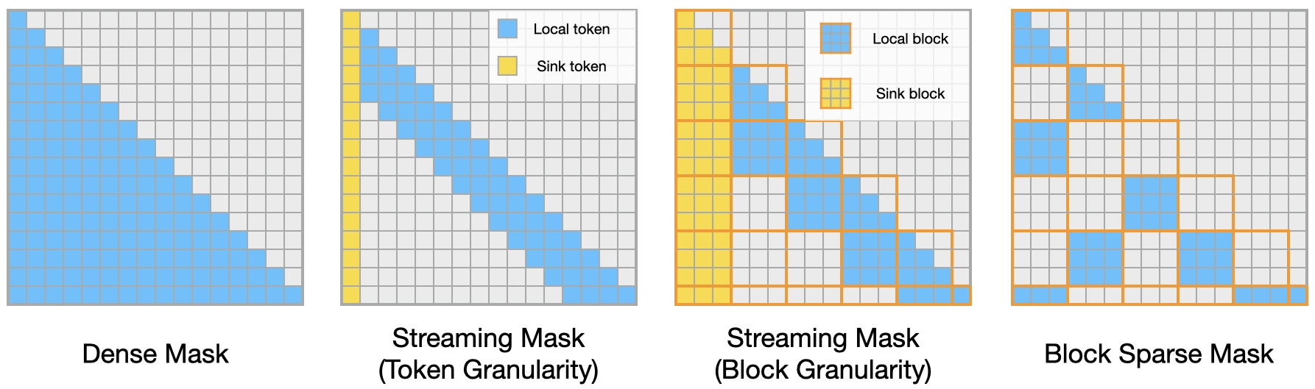
#1 Design masks that have block like structure
One Example: https://github.com/mit-han-lab/Block-Sparse-Attention
We will not discuss how to build these.

Slide 57
#2: Reorder Attention Masks
Resources:
Sharma, Agniv, and Jonas Geiping. "Efficiently Dispatching Flash Attention For Partially Filled Attention Masks." arXiv preprint arXiv:2409.15097 (2024).
Other Resource: “Exploring Binary Block Masking with Hypergraph-Based Token Reordering for GPU-Efficient Attention,” Kutay Tasci, Nathaniel Tomczak, Sanmukh Kuppannagari (Under review)
(Our technique is much better than the above, but still under review so unavailable for you to read. ;-) )

Slide 58
Introducing Sparsity in Flashattention
$$M$$
$$QK^{T}$$
$$B_{c}=B_{r}=2$$
#B =0
Lets calculate the number of blocks computed by FlashAttention

Slide 59
Introducing Sparsity in Flashattention
$$M$$
$$QK^{T}$$
$$B_{c}=B_{r}=2$$
#B =1
Lets calculate the number of blocks computed by FlashAttention

Slide 60
Introducing Sparsity in Flashattention
$$M$$
$$QK^{T}$$
$$B_{c}=B_{r}=2$$
#B = 2
Lets calculate the number of blocks computed by FlashAttention

Slide 61
Introducing Sparsity in Flashattention
$$M$$
$$QK^{T}$$
$$B_{c}=B_{r}=2$$
Do not process
#B = 2
Lets calculate the number of blocks computed by FlashAttention

Slide 62
Introducing Sparsity in Flashattention
$$M$$
$$QK^{T}$$
$$B_{c}=B_{r}=2$$
Do not process
#B = 2
Lets calculate the number of blocks computed by FlashAttention

Slide 63
Introducing Sparsity in Flashattention
$$M$$
$$QK^{T}$$
$$B_{c}=B_{r}=2$$
#B = 3
Lets calculate the number of blocks computed by FlashAttention

Slide 64
Introducing Sparsity in Flashattention
$$M$$
$$QK^{T}$$
$$B_{c}=B_{r}=2$$
#B = 5
Lets calculate the number of blocks computed by FlashAttention

Slide 65
Introducing Sparsity in Flashattention
$$M$$
$$QK^{T}$$
$$B_{c}=B_{r}=2$$
#B = ??
Lets calculate the number of blocks computed by FlashAttention

Slide 66
Introducing Sparsity in Flashattention
$$M$$
$$QK^{T}$$
$$B_{c}=B_{r}=2$$
#B = 12
Significant reduction in computations can be obtained if the number of blocks with non-zeros are less

Slide 67
Introducing Sparsity in Flashattention
$$M$$
$$QK^{T}$$
$$B_{c}=B_{r}=2$$
#B = 12
What could have led to an even better reduction in computation?

Slide 68
Introducing Sparsity in Flashattention
$$M$$
$$QK^{T}$$
$$B_{c}=B_{r}=2$$
#B = 12
What could have led to an even better reduction in computation?

Slide 69
Introducing Sparsity in Flashattention
$$M$$
$$QK^{T}$$
$$B_{c}=B_{r}=2$$
#B = 9
What could have led to an even better reduction in computation? If non-zero elements are packed closed to the diagonal

Slide 70
Introducing Sparsity in Flashattention
$$M$$
$$QK^{T}$$
$$B_{c}=B_{r}=2$$
#B = 9
However, we cannot simply take a non-zero and move it.

Slide 71
Introducing Sparsity in Flashattention
$$M$$
$$QK^{T}$$
$$B_{c}=B_{r}=2$$
#B = 9
However, we cannot simply take a non-zero and move it.
Solution: Matrix Reordering

Slide 72
Matrix Reordering
A key preprocessing step in scientific computations
Given a sparse matrix, reorder rows/columns with the following objective:
Minimize bandwidth: Longest distance across row from the diagonal elements
Fill in: Number of entries that change from 0 to non-zero, typically after matrix factorization
This link provides a good visualization: https://www.mathworks.com/help/matlab/math/sparse-matrix-reordering.html

Slide 73
Matrix Reordering
In our case, the sparse matrix is an adjacency matrix of a graph
For undirected graphs: adjacency matrix is symmetric
For masks that are non-causal, attention masks are symmetric
And we do not need to do any factorization, so we don’t care about Fill in
So, the problem boils down to: Relabel the vertices of the graph to minimize bandwidth

Slide 74
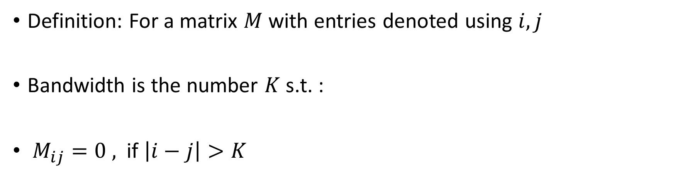
Bandwidth
Definition: For a matrix $M$ with entries denoted using $i,j$
Bandwidth is the number $K$ s.t. :
$M_{ij}=0 ,$ if $\left|i−j\right|>K$

Slide 75
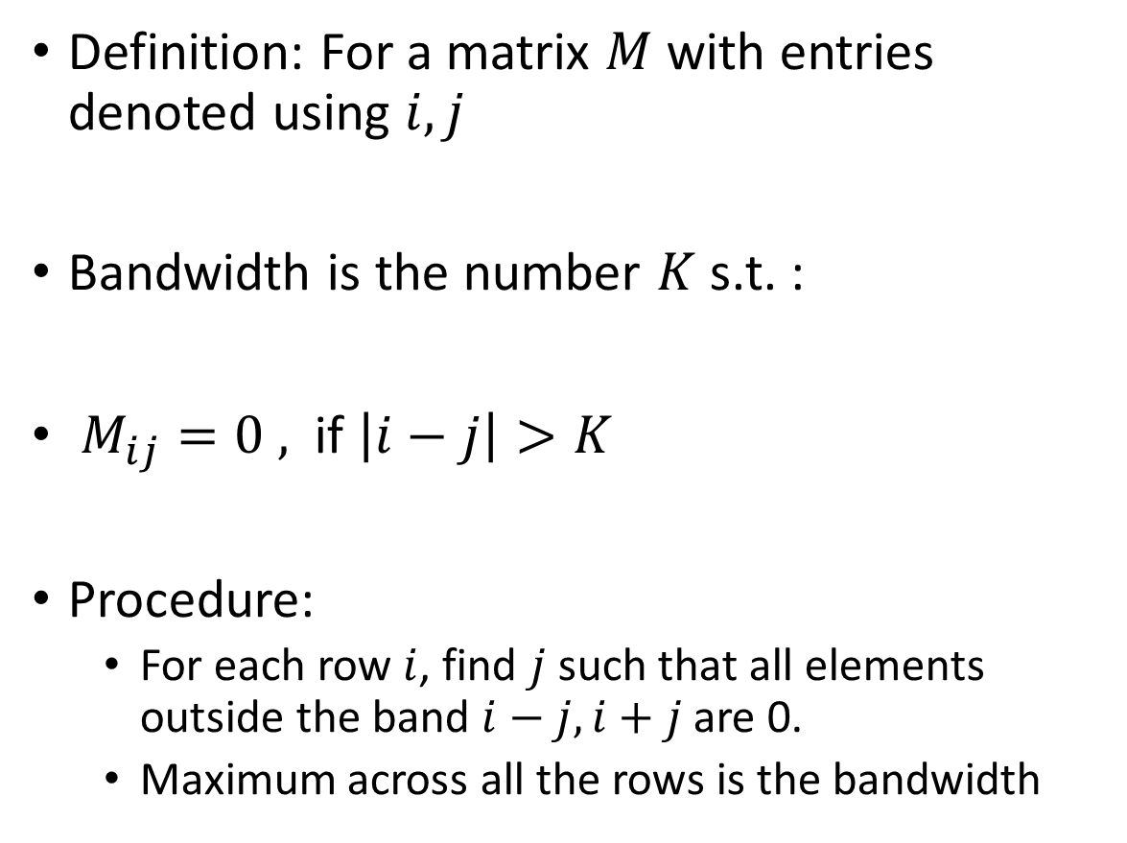
Bandwidth
Definition: For a matrix $M$ with entries denoted using $i,j$
Bandwidth is the number $K$ s.t. :
$M_{ij}=0 ,$ if $\left|i−j\right|>K$
Procedure:
For each row $i$, find $j$ such that all elements outside the band $i−j, i+j$ are 0.
Maximum across all the rows is the bandwidth

Slide 76

Bandwidth
Definition: For a matrix $M$ with entries denoted using $i,j$
Bandwidth is the number $K$ s.t. :
$M_{ij}=0 ,$ if $\left|i−j\right|>K$
Procedure:
For each row $i$, find $j$ such that all elements outside the band $i−j, i+j$ are 0.
Maximum across all the rows is the bandwidth
$$i=0$$
$$j=1$$
$$K=1$$

Slide 77

Bandwidth
Definition: For a matrix $M$ with entries denoted using $i,j$
Bandwidth is the number $K$ s.t. :
$M_{ij}=0 ,$ if $\left|i−j\right|>K$
Procedure:
For each row $i$, find $j$ such that all elements outside the band $i−j, i+j$ are 0.
Maximum across all the rows is the bandwidth
$$i=2$$
$$j= ??$$
$$K= ??$$

Slide 78

Bandwidth
Definition: For a matrix $M$ with entries denoted using $i,j$
Bandwidth is the number $K$ s.t. :
$M_{ij}=0 ,$ if $\left|i−j\right|>K$
Procedure:
For each row $i$, find $j$ such that all elements outside the band $i−j, i+j$ are 0.
Maximum across all the rows is the bandwidth
$$i=2$$
$$j=7$$
$$K=5$$

Slide 79

Bandwidth
Definition: For a matrix $M$ with entries denoted using $i,j$
Bandwidth is the number $K$ s.t. :
$M_{ij}=0 ,$ if $\left|i−j\right|>K$
Procedure:
For each row $i$, find $j$ such that all elements outside the band $i−j, i+j$ are 0.
Maximum across all the rows is the bandwidth
$$i=5$$
$$j=0$$
$$K=5$$

Slide 80

Bandwidth
Definition: For a matrix $M$ with entries denoted using $i,j$
Bandwidth is the number $K$ s.t. :
$M_{ij}=0 ,$ if $\left|i−j\right|>K$
Procedure:
For each row $i$, find $j$ such that all elements outside the band $i−j, i+j$ are 0.
Maximum across all the rows is the bandwidth
$$i=7$$
$$j=0$$
$$K=7$$

Slide 81
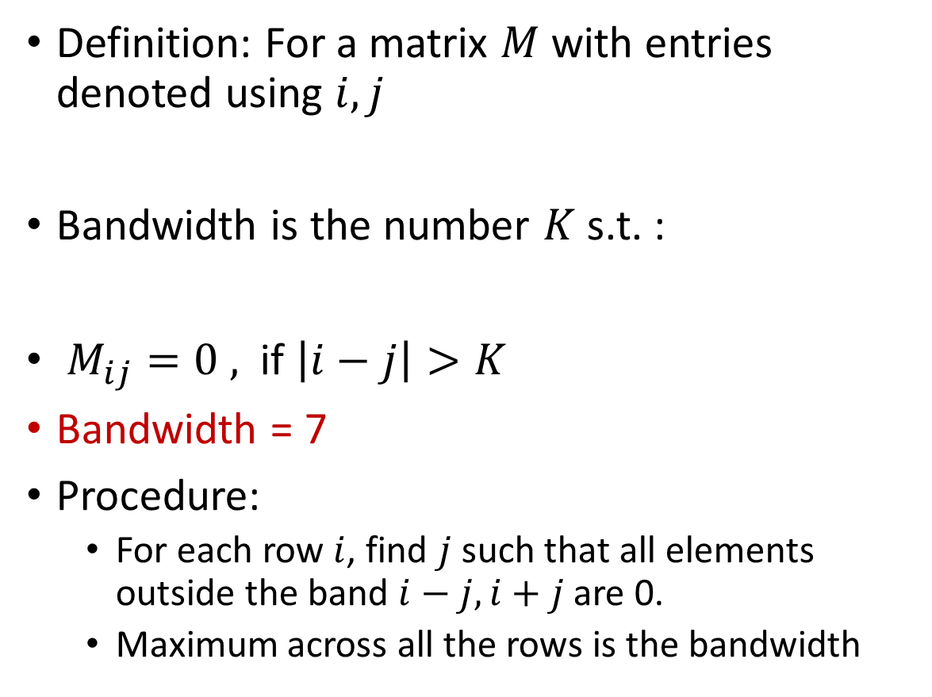
Bandwidth
Definition: For a matrix $M$ with entries denoted using $i,j$
Bandwidth is the number $K$ s.t. :
$M_{ij}=0 ,$ if $\left|i−j\right|>K$
Bandwidth = 7
Procedure:
For each row $i$, find $j$ such that all elements outside the band $i−j, i+j$ are 0.
Maximum across all the rows is the bandwidth
$$i=7$$
$$j=0$$
$$K=7$$

Slide 82

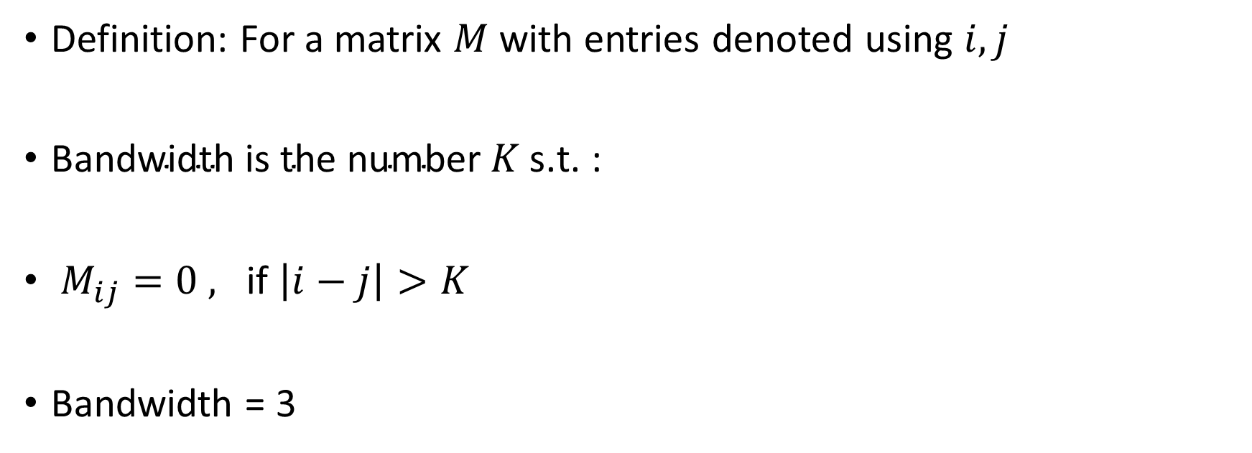
Bandwidth – After Reordering
Definition: For a matrix $M$ with entries denoted using $i,j$
$\text{Bandwidth} \text{is} \text{the} \text{number} K \text{s}\text{.}\text{t}\text{. :}$
$M_{ij}=0 , \text{if} \left|i−j\right|>K$
Bandwidth = 3
A lower bandwidth is being used as a proxy for better packing
$$K=3$$

Slide 83
Graph Vertex Relabling
1
4
3
4
2
1
2
3
Notice how the adjacency matrix changes with the reordering of the vertices

Slide 84
Graph Vertex Relabling
1
4
3
4
2
1
2
3
Graph Bandwidth Minimization: Finding a re-ordering of graph to minimize the bandwidth of its corresponding adjacency matrix

Slide 85
Graph Vertex Relabling
1
4
3
4
2
1
2
3
https://en.wikipedia.org/wiki/Graph_bandwidth
This problem is NP-hard

Slide 86
Graph Vertex Relabling
1
4
3
4
2
1
2
3
https://en.wikipedia.org/wiki/Graph_bandwidth
This problem is NP-hard
Fast heuristics exists

Slide 87
Cuthill–McKee algorithm (CM)
Given a square symmetric matrix that is an adjacency matrix of a graph, relabel the vertices to obtain low bandwidth in the matrix
Cuthill, Elizabeth, and James McKee. "Reducing the bandwidth of sparse symmetric matrices." Proceedings of the 1969 24th national conference. 1969. https://dl.acm.org/doi/pdf/10.1145/800195.805928
Type written, uses fortran to discuss the algorithm. It is a fun read.

Slide 88
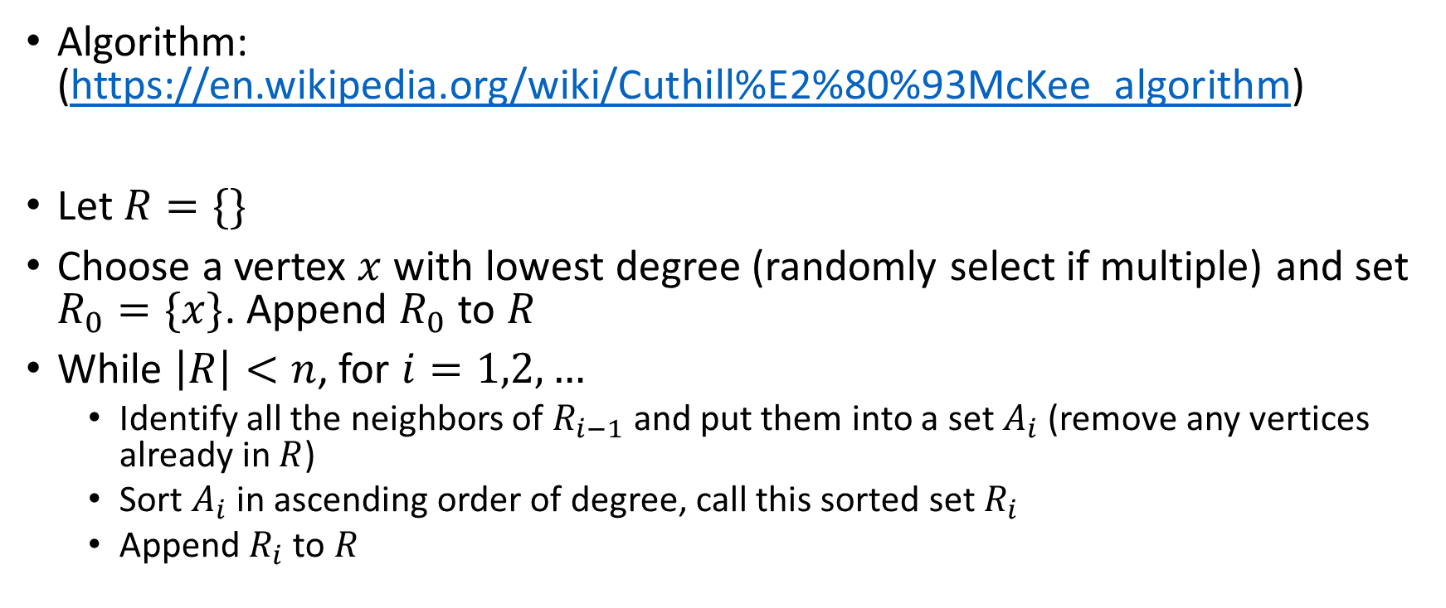
Cuthill–McKee algorithm (CM)
Algorithm: (https://en.wikipedia.org/wiki/Cuthill%E2%80%93McKee_algorithm)
Let $R=\{\}$
Choose a vertex $x$ with lowest degree (randomly select if multiple) and set $R_{0}=\{x\}$. Append $R_{0}$ to $R$
While $\left|R\right|<n$, for $i=1,2,…$
Identify all the neighbors of $R_{i−1}$ and put them into a set $A_{i}$ (remove any vertices already in $R$)
Sort $A_{i}$ in ascending order of degree, call this sorted set $R_{i}$
Append $R_{i}$ to $R$

Slide 89
Cuthill–McKee algorithm (CM)

Slide 90
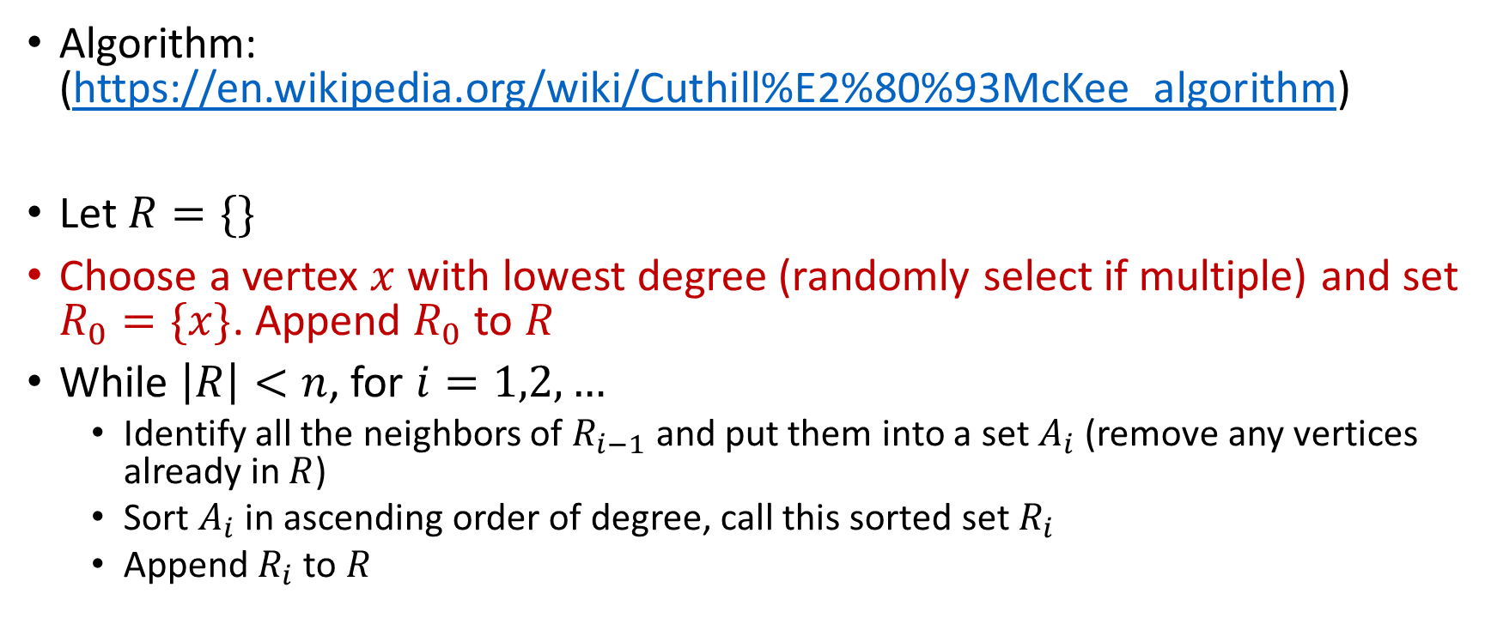
Cuthill–McKee algorithm (CM)
Algorithm: (https://en.wikipedia.org/wiki/Cuthill%E2%80%93McKee_algorithm)
Let $R=\{\}$
Choose a vertex $x$ with lowest degree (randomly select if multiple) and set $R_{0}=\{x\}$. Append $R_{0}$ to $R$
While $\left|R\right|<n$, for $i=1,2,…$
Identify all the neighbors of $R_{i−1}$ and put them into a set $A_{i}$ (remove any vertices already in $R$)
Sort $A_{i}$ in ascending order of degree, call this sorted set $R_{i}$
Append $R_{i}$ to $R$

Slide 91
Cuthill–McKee algorithm (CM)

Slide 92
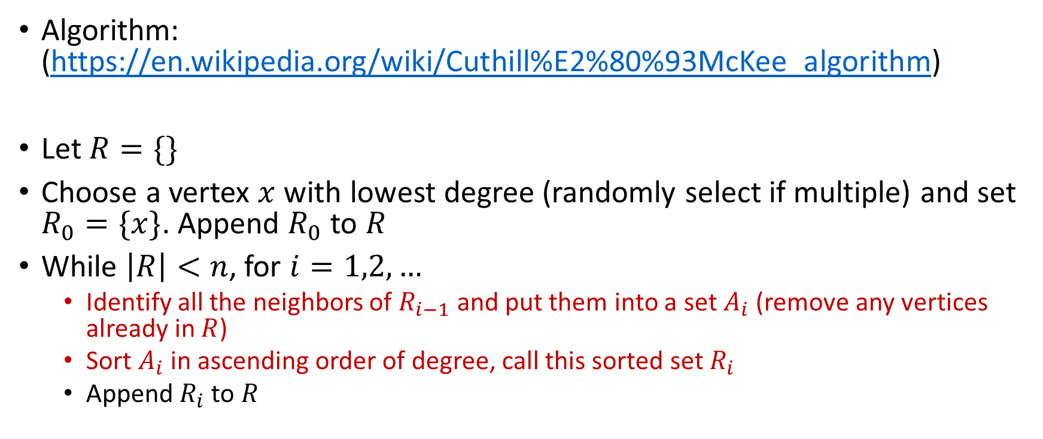
Cuthill–McKee algorithm (CM)
Algorithm: (https://en.wikipedia.org/wiki/Cuthill%E2%80%93McKee_algorithm)
Let $R=\{\}$
Choose a vertex $x$ with lowest degree (randomly select if multiple) and set $R_{0}=\{x\}$. Append $R_{0}$ to $R$
While $\left|R\right|<n$, for $i=1,2,…$
Identify all the neighbors of $R_{i−1}$ and put them into a set $A_{i}$ (remove any vertices already in $R$)
Sort $A_{i}$ in ascending order of degree, call this sorted set $R_{i}$
Append $R_{i}$ to $R$

Slide 93
Cuthill–McKee algorithm (CM)

Slide 94
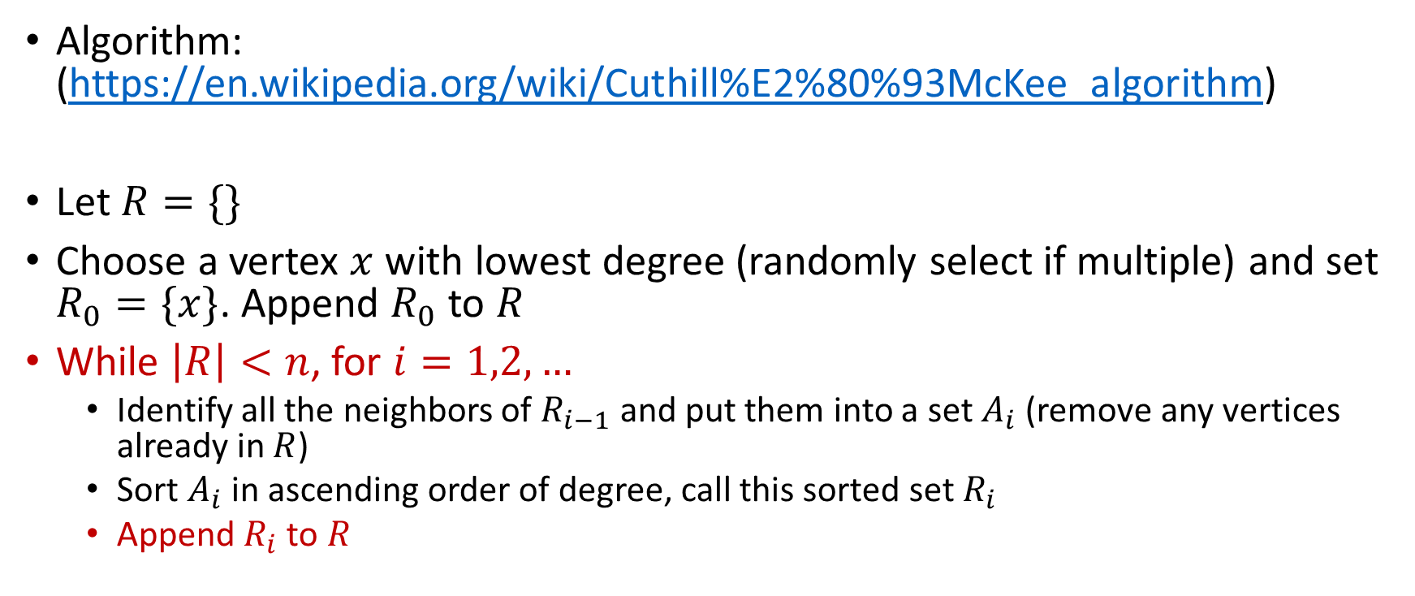
Cuthill–McKee algorithm (CM)
Algorithm: (https://en.wikipedia.org/wiki/Cuthill%E2%80%93McKee_algorithm)
Let $R=\{\}$
Choose a vertex $x$ with lowest degree (randomly select if multiple) and set $R_{0}=\{x\}$. Append $R_{0}$ to $R$
While $\left|R\right|<n$, for $i=1,2,…$
Identify all the neighbors of $R_{i−1}$ and put them into a set $A_{i}$ (remove any vertices already in $R$)
Sort $A_{i}$ in ascending order of degree, call this sorted set $R_{i}$
Append $R_{i}$ to $R$

Slide 95
Cuthill–McKee algorithm (CM)

Slide 96
Cuthill–McKee algorithm (CM)

Slide 97
Cuthill–McKee algorithm (CM)
Ungraded HW assignment: Try to run the algorithm on a graph of your choice and see if you understand.
Reverse Cuthill–McKee algorithm (RCM): Same as CM, but reverse the node numbering
Leads to lower fill-in after factorization (beyond the scope of this class)

Slide 98
Going back: Introducing Sparsity in Flashattention
$$M$$
$$QK^{T}$$
$$B_{c}=B_{r}=2$$
What could have led to an even better reduction in computation?

Slide 99
Going back: Introducing Sparsity in Flashattention
$$M$$
$$QK^{T}$$
$$B_{c}=B_{r}=2$$
What could have led to an even better reduction in computation? RCM algorithm before calling the modified flashattention

Slide 100
Sparsity in Attention
Reorder attention masks to reduce the number of blocks
Call Flashattention, to only operate on non-zero blocks
Caveats:
Reordering takes time, so not applicable to all use cases
Sometimes the block structure may become worse
Our proposed technique: Using bandwidth as a proxy for reducing the number of blocks works well for scientific computing, but not for attention masks
Use hypergraph partitioning techniques that directly optimize for reducing the number of blocks

Slide 101
Next Class
11/6 Lecture 20
Modeling Cluster of Accelerators

Slide 102
Thank You
Questions?
Email: sanmukh.kuppannagari@case.edu

